Slide 1
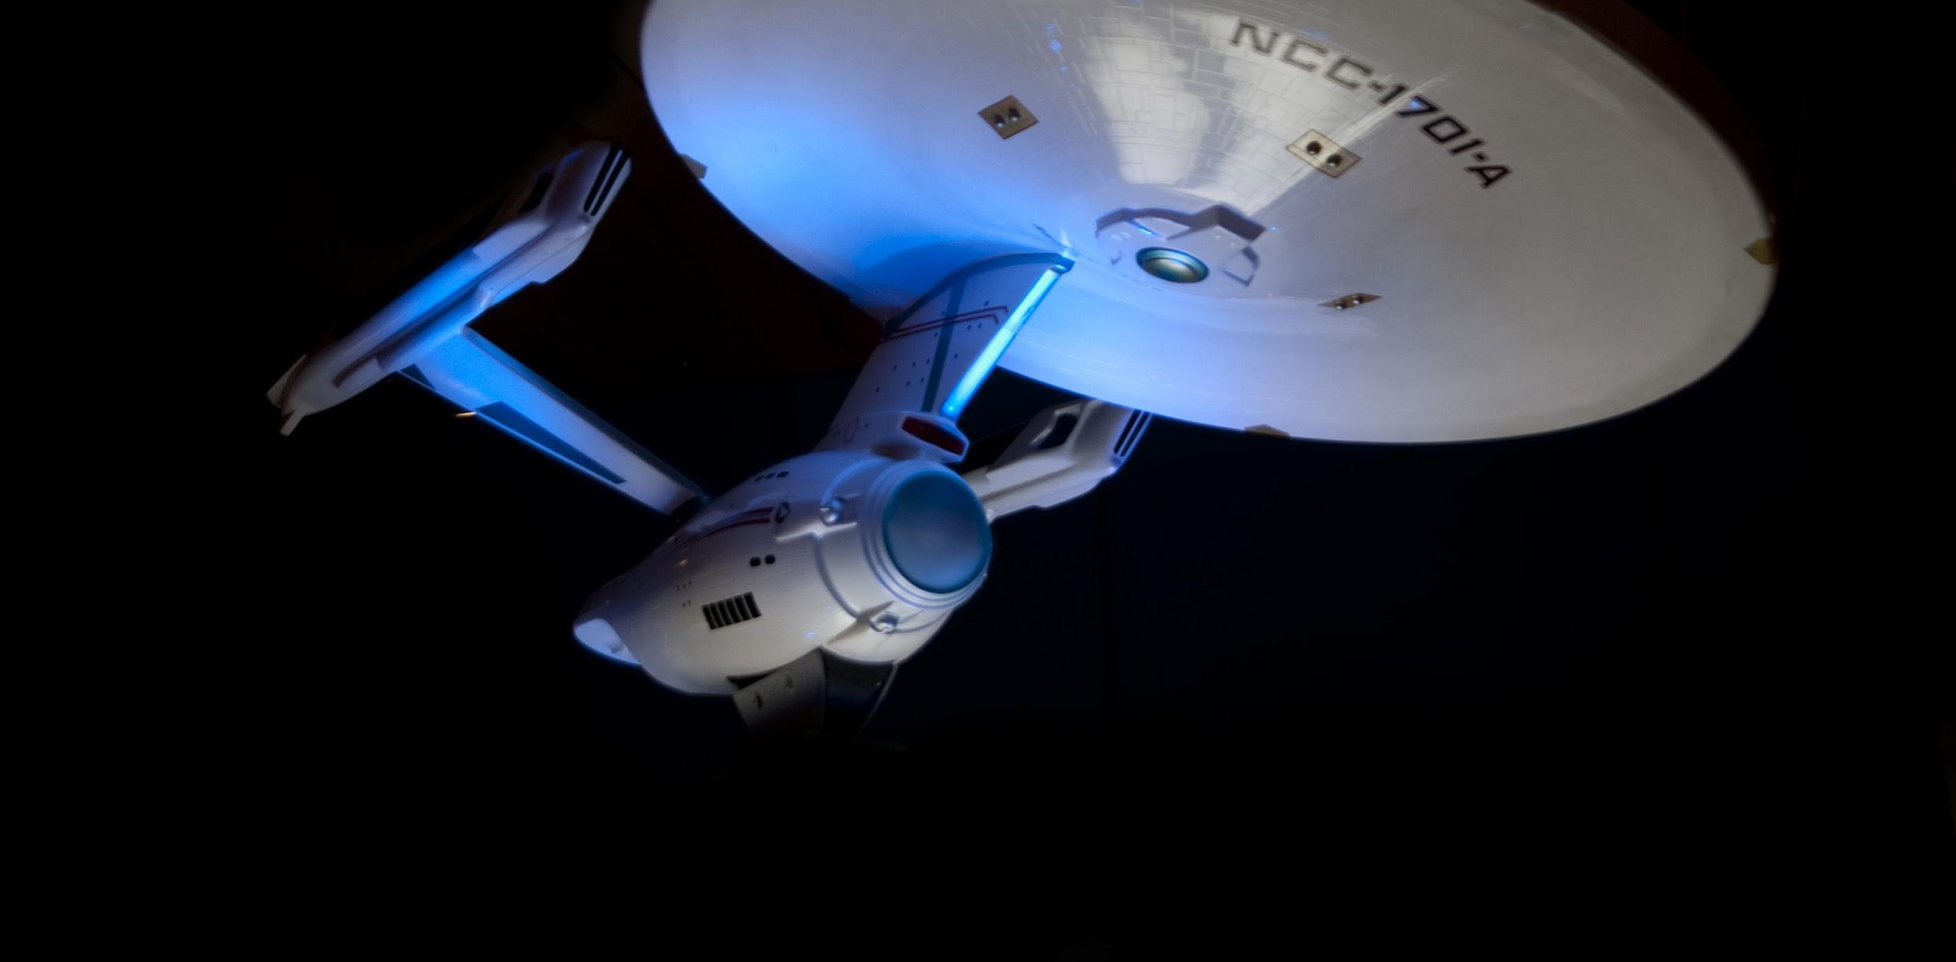

AI Explorers
Starring:
Leidy
Andres
Dimitris
Carlos
Hesheng
“...to boldly go where no one has gone before”

Slide 2
BUSINESS PROBLEM
INITIAL BUSINESS PROBLEM PROPOSED
FINAL PROBLEM SOLVED
Predict Fire Risk Level for each house in the city based on distance from fire incidents
01
Prediction
Predict the daily number of interventions for each Fire station in the city of Montreal
Determine property-level fire risk: likelihood of a given property having a fire incident in a
given 6-month time period
02
Prevention

Slide 3
EXTERNAL DATA USED
House Risk Level - based on distance from fire incident
The interventions data from the fire department of the city of Montreal
Sample of house's data from Centris
01
Property Fire Predictor - based on four (4) closest incidents from center of borough
The interventions data from the fire department of the city of Montreal
The 2016 Census for the Agglomeration de Montreal
The data about Crime in Montreal
Data on the properties' location, size, year built, lot area, etc. from the city of Montreal
02

Slide 4
DATA ANALYSIS TOOLS & TECHNIQUES
House Risk Level - based on distance from fire incident
01
Tools
Techniques
Github
Python
Java
Jupyter Notebook
Excel
Decision Tree Regression
Property Fire Predictor - based on four closest incidents from center of borough
02
Tools
Techniques
Github
Python
Alteryx
Tableau
Excel
Decision Tree
Random Forest
XG Boost

Slide 5






DATA ANALYSIS TOOLS & TECHNIQUES
Google Cloud Platform & Alteryx
Data Exploration
Data Storage
Data pipelines
Build ML models
At very first step we required to understand an initial data trend and patterns that could drive us to a possible need in terms of ML.
Tools:
We rapidly noticed a huge need in terms of storage for all the data we were gathering for a broad of purposes, the picked tool must fit with any format of data.
Tools:
In order to cover all the different perspectives we had on the ML model it was required to explore external data that had to be manipulated to fit within the project
Tools:
On the final stage, once all the workflow had been achieved successfully we finally proceeded to design and build the ML models would fulfill the prediction needs.
Tools:
BigQuery
Cloud Storage
Cloud Datalab
Cloud Dataflow
Cloud Datalab

Slide 6
MODEL 01 - ASSUMPTIONS
House Risk Level - based on distance from fire incident
Sample Centris data
The model considered some Montreal houses only – discarded other types of constructions e.g. schools, commercial buildings, etc.
Used fire incidents only – discarded other types of incidents e.g. flood, traffic accident, etc.
Used house’s characteristics only as the features for the model, such as lot size, borough, year built, price, etc. – did not use external additional data
01

Slide 7
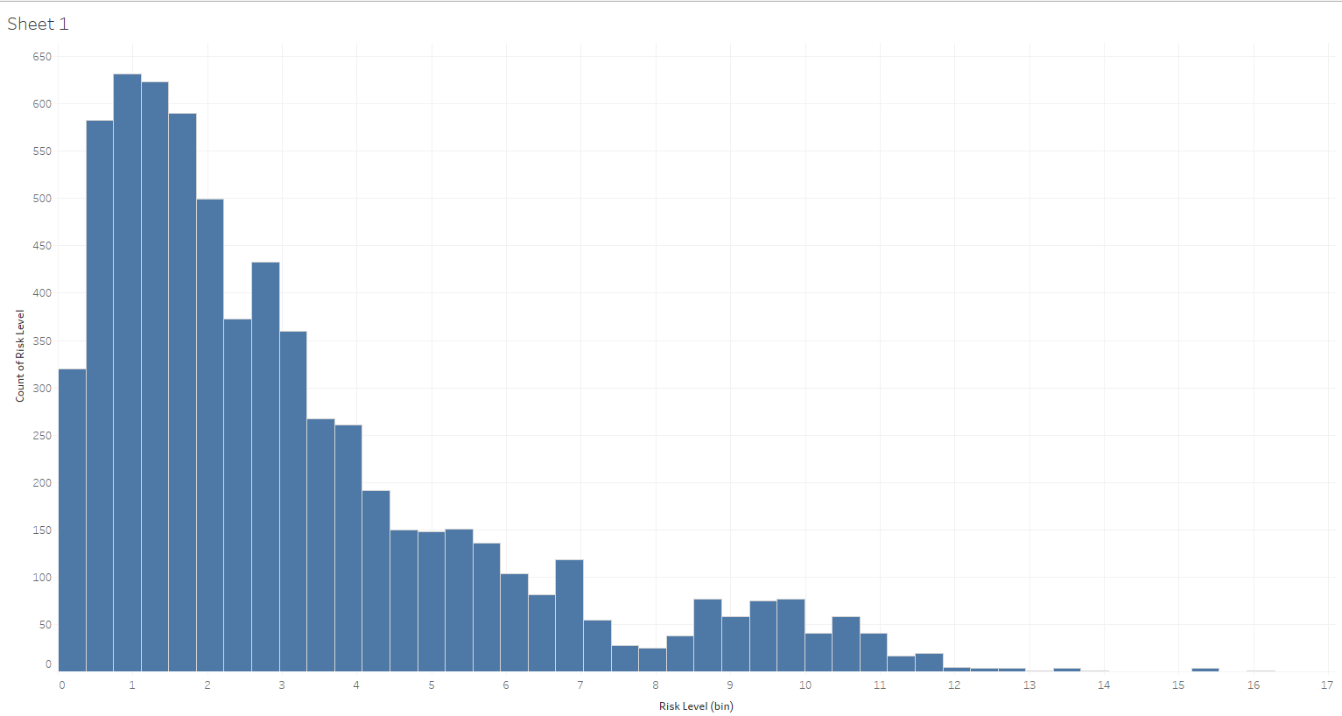
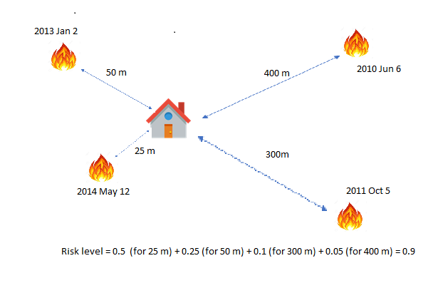
MODEL 01 - ASSUMPTIONS
Assign house fire risk level based on distances from past fires
01

Slide 8
MODEL 01 - DATA PREPROCESSING
01
Data Pipeline
Fire Incident data
Java Application
Python
Centris data
Join and clean raw data
House data with risk level
ML modeling & prediction

Slide 9
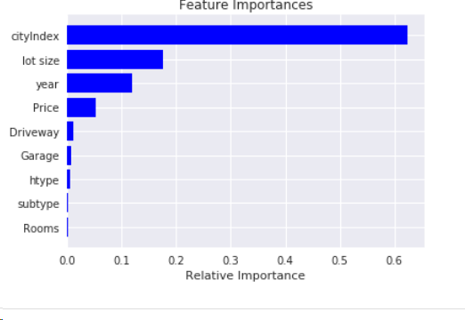
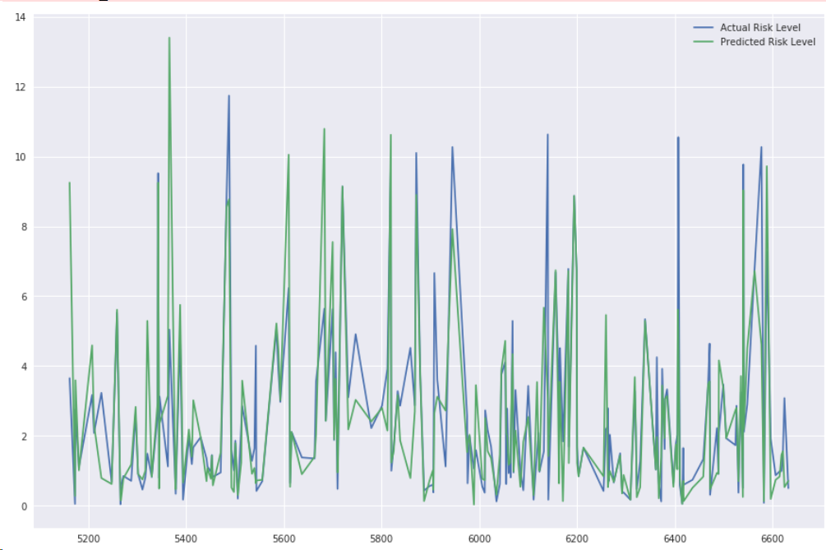
MODEL 01 - FINDINGS & RESULTS
Feature Importance
Model statistics summary
Mean Absolute Error: 1.03
Mean Squared Error: 3.26
Root Mean Squared Error: 1.80
R2_score: 0.59

Slide 10
MODEL 01 - FINDINGS & RESULTS
House Risk Level - based on distance from fire incident
The threshold for cutting 5% higher risk level houses is 9.2
 | Predict Not High Risk | Predict High Risk
Actual Not High Risk | 781 | 23
Actual High Risk | 25 | 29

Slide 11

MODEL 02 - ASSUMPTIONS
Six Months Fire Predictor Modeling
Assumed that the data from Census Canada is smoothly distributed across the boroughs
as show here: (We actually used values from 4 boroughs, but here we show only 2 for simplicity)
The model used 6 months of historical (past) data and looked 6 months into the future
02
500m
500m
Center Outremont
known value: 500K
Borders Outremont - CDN calculated value = 400K
Center Cote De Neiges (CDN)
known value: 300K
Features not included in the model |  | Features |  | Label
Location - not used as a predictor in the model, only to join data | Date - not used as a predictor, only to create table | History related features looking back 6 months (7 features) Sum_Autres_incendies, Sum_Incendie_de_batiments, Sum_Premier_Repondant, Sum_Sans_incendie, Sum_Alarmes_incendies, Sum_False_Alertes_Annulations, Sum_Crime. | Location related features (25 features) | Was there a fire in the NEXT 6 months? (look into the future to respond)

Slide 12
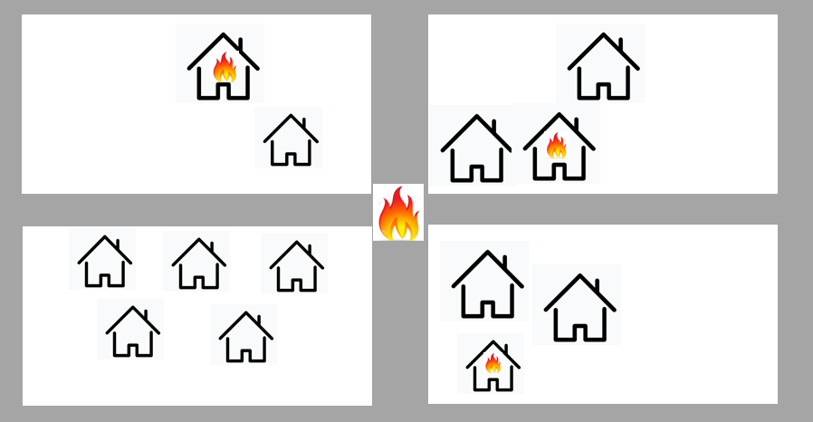
MODEL 02 - ASSUMPTIONS
Assumed that the street intersection where the incident is projected is the location where the incident occurred and we estimate its features as the average of the properties that project there.
02
Features used (averaged)
Year built
Lot size
Area of the house
Number of floors

Slide 13
MODEL 02 - DATA PREPROCESSING
Data Pipeline
Merge External Data Sets
Alteryx and Excel
Alteryx
Python
Python
Tableau
Intervention data
Enrich Intervention Location with features from External Data
Perform History analysis per location and prepare label
Run several models to predict future fire in location.
Analyze performance of models and select the Best performing
Created Visualization in Tableau

Slide 14
MODEL 02 - FINDINGS & RESULTS
Summary of the three (3) ML models we used - Winner is Random Forest
Model | Recall | Precision | F1_Score | Kappa | AUC
Decision Tree | 45.5% | 43.9% | 44.7% | 40.3% | 0.72
Random Forest | 44.6% | 61.7% | 51.8% | 48.6% | 0.90
XG Boost | 12.9% | 81.4% | 22.3% | 20.7% | 0.90
Confusion Table 34% of total data |  | Predicted
 |  | No Fire | Fire
Actual | No Fire | 181,173 | 4,045
 | Fire | 8,105 | 6,524
XG Boost misses fires for the sake of better prediction accuracy. This is why this model was not selected as the winner.

Slide 15
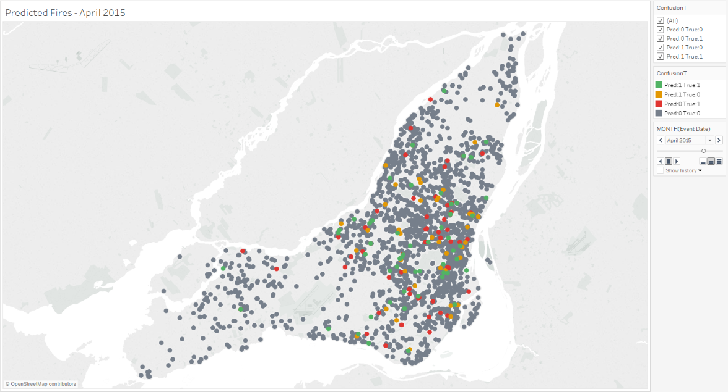
MODEL 02 - FINDINGS & RESULTS

Slide 16
PROJECT MANAGEMENT
Tools used to develop and manage the project
Project Management: Trello, Team Charter
Presentation: Prezi, Google Slides
Communication & Collaboration: Slack, Email & Tasks on Trello board, Hangouts
Data Visualization: Tableau, Python, Data Studio
Data Preparation: Excel, Data Lab, Big Query, Python, Alteryx, Java
ML: Python, Alteryx, Data Lab, Jupyter Notebook, Colaboratory
Work Methodology: Kanban on Trello
Github
Google Drive, Google Suite: Docs, Sheets
Project Deliverables
Two PDF reports: House Risk Level Modeling & Six Months Fire Predictor Modeling
ML Models
Project Documentation & related work e.g. Alteryx & Python workflows
How will the project be archived?
Github & Google Drive

Slide 17
CHALLENGES & CONSTRAINTS
Challenges the team faced
Not enough data available to train and test the model
Quality of data: obfuscated data without actual property address
Hard to meet in person as all team members were busy during business hours
Difficulties in agreeing where we wanted to go and what we wanted to predict
Difficulties in finding additional external data to leverage the quality of data
We found the project proposed too generic and hypothetical, therefore subject to open interpretations
Difficulties setting up GCP platform - new tech. learning curve
Not enough time in class to discuss the project
Not enough time to present and explore work done during the presentations

Slide 18


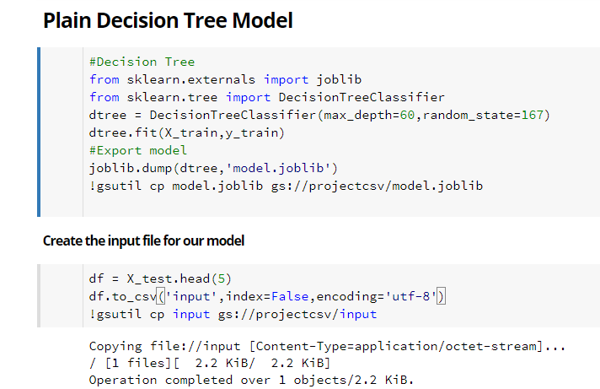





ML DEPLOYMENT FLOW / DEMO
ML model deployment pipeline
Sample code to export model
App Engine
Cloud Functions
Output sample
https://us-central1-mcgillcapstone.cloudfunctions.net/launch_prediction
Cloud Machine Learning Engine
Cloud Storage

Slide 19
CONCLUSIONS & FUTURE WORK
the first one predicting fire risk level of houses based on distance from incidents.
the second predicting the likelihood of fire in a specific intersection in the next 6-month period based on the location history and characteristics.
Finally we believe that this work, along with the other deliverables produced, if leveraged with more and real data, would prove to be useful for the Fire Department as a tool to improve public safety, resources planning and allocation, and detect and combat fires in the city of Montreal.
Notes:
We were provided with data from the city of Montreal and given the mission to help the Fire Department in the combat of fire. Although we knew we did not have enough data and that this was a hypothetical problem with a tight deadline, we benefited from a fruitful, productive teamwork without whose support and commitment this project would not have been possible.
We were able to design two different approaches that focused on prediction and prevention of fire based on the same principles although using varied techniques to leverage the data, and looking at different aspects of the properties located closed to the incidents. Both models were able to yield good results - the first one predicting fire risk level of houses based on distance from incidents and the second predicting the likelihood of fire in a specific intersection in the next 6-month period based on the location history and characteristics.
During the project the team was able to test external data e.g. weather data - that was in the end discarded, and add more important and relevant data like crime information, data from Census Canada, to enrich the models. Due to data constraints we had to make a lot of assumptions but we believe they do not invalidate the results achieved for the purposes of this capstone project.
Finally we believe that this work, along with the other deliverables produced, if leveraged with more and real data, would prove to be useful for the Fire Department as a tool to improve public safety, resources planning and allocation, and detect and combat fires in the city of Montreal.

Slide 20
AI Explorers
AI Explorers
THANK YOU!
“...to boldly go where no one has gone before”

Slide 21
APPENDIX

Slide 22
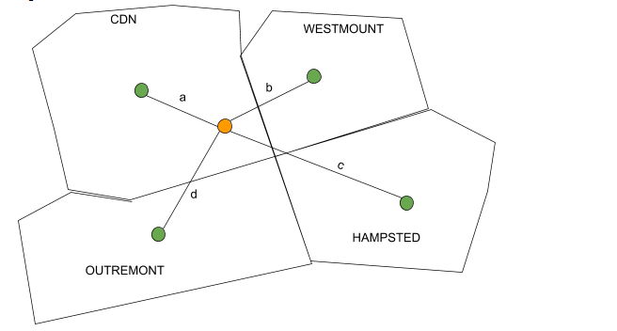
MODEL 02 - ASSUMPTIONS
02
Calculate the center of the borough

Slide 23
MODEL 02 - FINDINGS & RESULTS
02
Feature Importance
0 Sum_Autres_incendies 5.627817
1 Sum_Incendie_de_batiments 4.416537
2 Sum_Premier_Repondant 23.562459
3 Sum_Sans_incendie 14.230483
4 Sum_Crime 0.223628
5 Sum_Alarmes_incendies 12.848393
6 Sum_False_Alertes_Annulations 0.466472
7 Couples_No_Children 1.352183
8 CouplesWithChildren 1.376694
9 SizeOF House 1.478065
10 Detached_House 1.527576
11 Appartment_FiveFloors 1.497550
12 OtherType 1.347506
13 Semi_detached 1.426204
14 TownHouse 1.550613
15 Duplex 1.474393
16 Appartment_less_5Florrs 1.332883
17 OtherDtached 1.456652
18 MObileHome 1.499862
19 1_4Rooms 1.328204
20 5_rooms 1.365861
21 6_rooms 1.373940
22 7_rooms 1.387381
23 8_RoomsOrmore 1.461079
24 Average_Rooms 1.424583
25 Simple_Maintenance 1.289666
26 Major_repairs 1.351905
27 Average_House_Value 1.445947
28 AverageHouseholdIncome2015 1.485375
29 Avg_flors 1.853714
30 Avg_YearBuilt 1.669168
31 Avg_LandArea 1.852248
32 Avg_HomeArea 2.014959

Slide 24
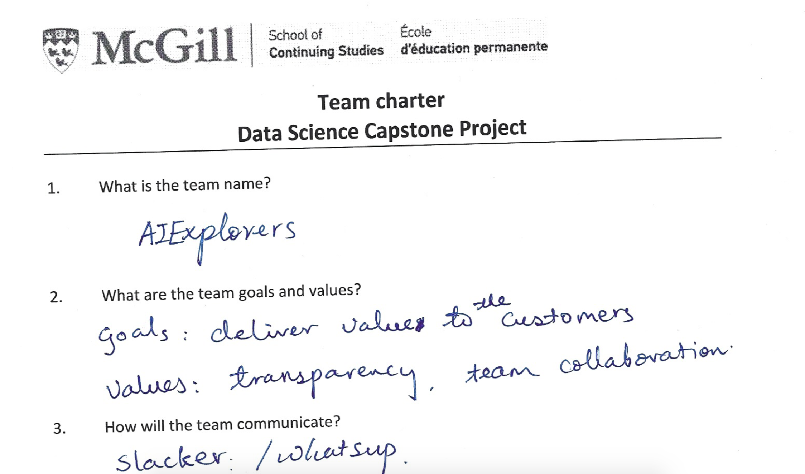
TEAM CHARTER

Slide 25
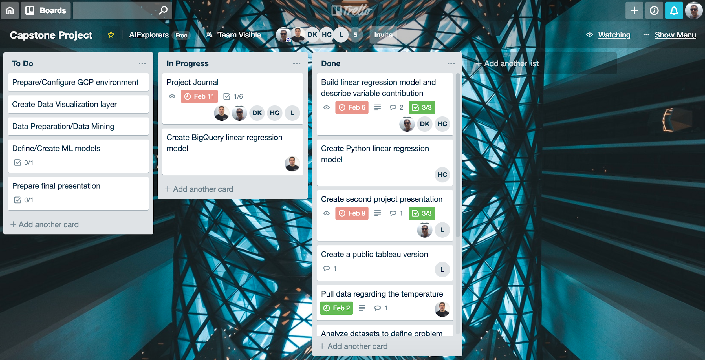
TRELLO - KANBAN BOARD

